Slide 1

The Internet

Slide 2
But first … Comunications
Application
Application Layers
Presentation
Session
Transport Layer
Transport
Internet Layer
Network
Data Link
Network Access
Physical

Slide 3
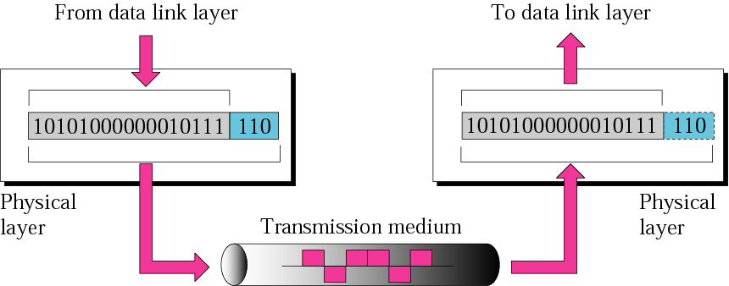
Physical Layer
The physical layer is responsible for the movement of individual bits from one hop (node) to the next.

Slide 4
OSI Model
Protocols
Protocols - Layer 7 | HTTP, FTP, SMTP, POP, DNS, Telnet
Protocols - Layer 6 | Graphics: TIFF, JPEG, GIF Text: ASCII, EBCDIC, Unicode, Encrypted Audio: Midi, MPEG, WAV, MP3 Video: Quicktime, AVI
Protocols - Layer 5 | NFS - Network File System, RPC - Remote Procedure Call, ASP - Appletalk Session Protocol
Protocols - Layer 4 | Connection Oriented (TCP), Connectionless (UDP)
Protocols - Layer 3 | Routing (IP)
Protocols - Layer 2 | MAC - Media Access Control, LLC - Logical Link Control
Protocols - Layer 1 | Organizations: IEE, TIA/ETA, ANSI, etc. Cable (ie. RJ45)

Slide 5
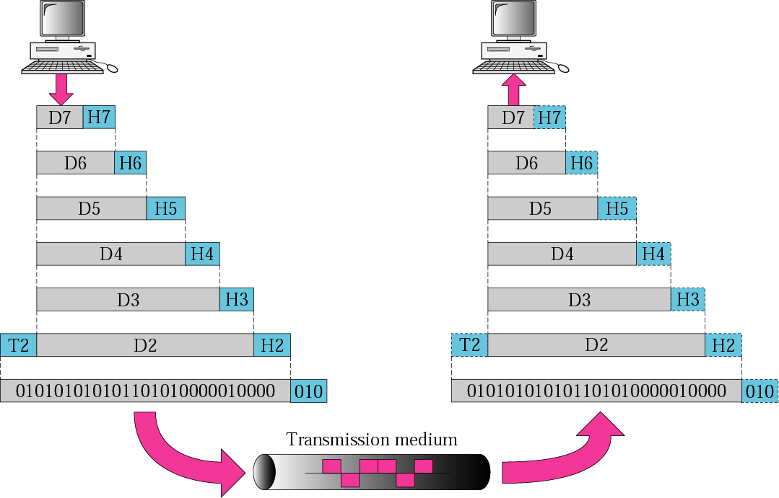
Data Encapsulation
OSI Model
The headers and trailers contain control information.
The headers and trailers form the envelope which carries the message to the desired destination.

Slide 6
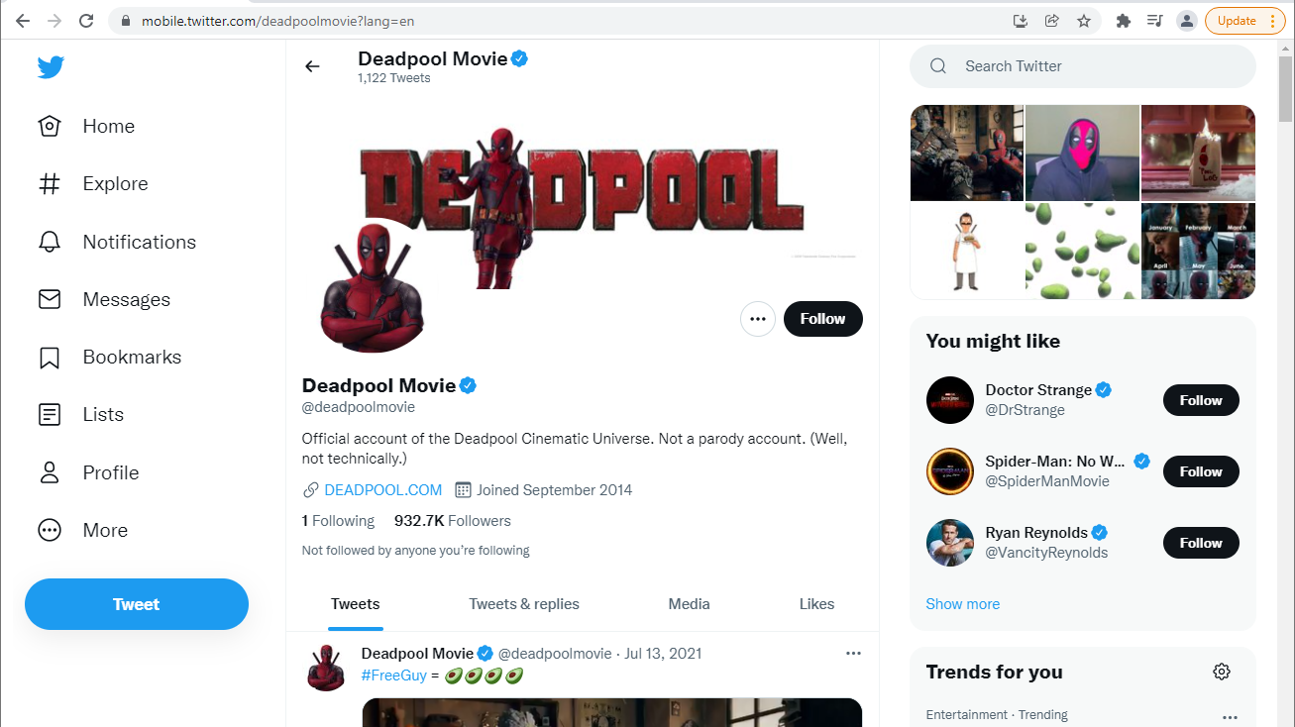

Slide 7
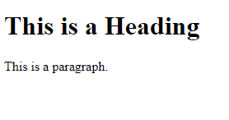
HTML
<!DOCTYPE html> <html> <head> <title>Page Title</title> </head> <body> <h1>This is a Heading</h1> <p>This is a paragraph.</p> </body> </html>

Slide 8
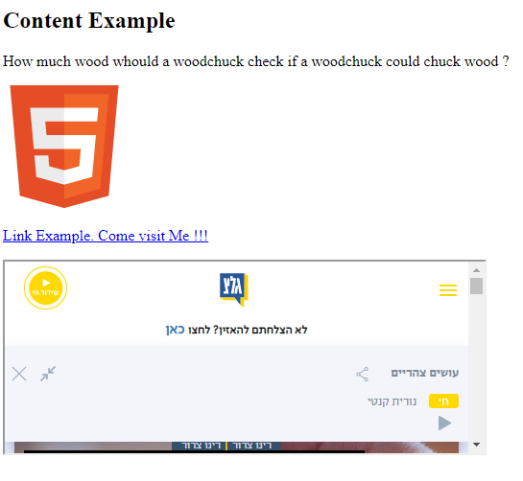
HTML
<!DOCTYPE html>
<html>
<head>
<style>img { width: 100%; } </style>
</head>
<body>
<h2>Content Example</h2>
<p>How much wood would a woodchuck check if a woodchuck could chuck wood ?</p>
<img src="html5.gif" alt="HTML5 Icon" style="width:128px;height:128px;">
<p><a href="https://www.w3schools.com/">Link Example. Come visit Me !!!</a></p>
<iframe src="https://glz.co.il/" height="200" width="500" title="Iframe Example"></iframe>
</body>
</html>

Slide 9
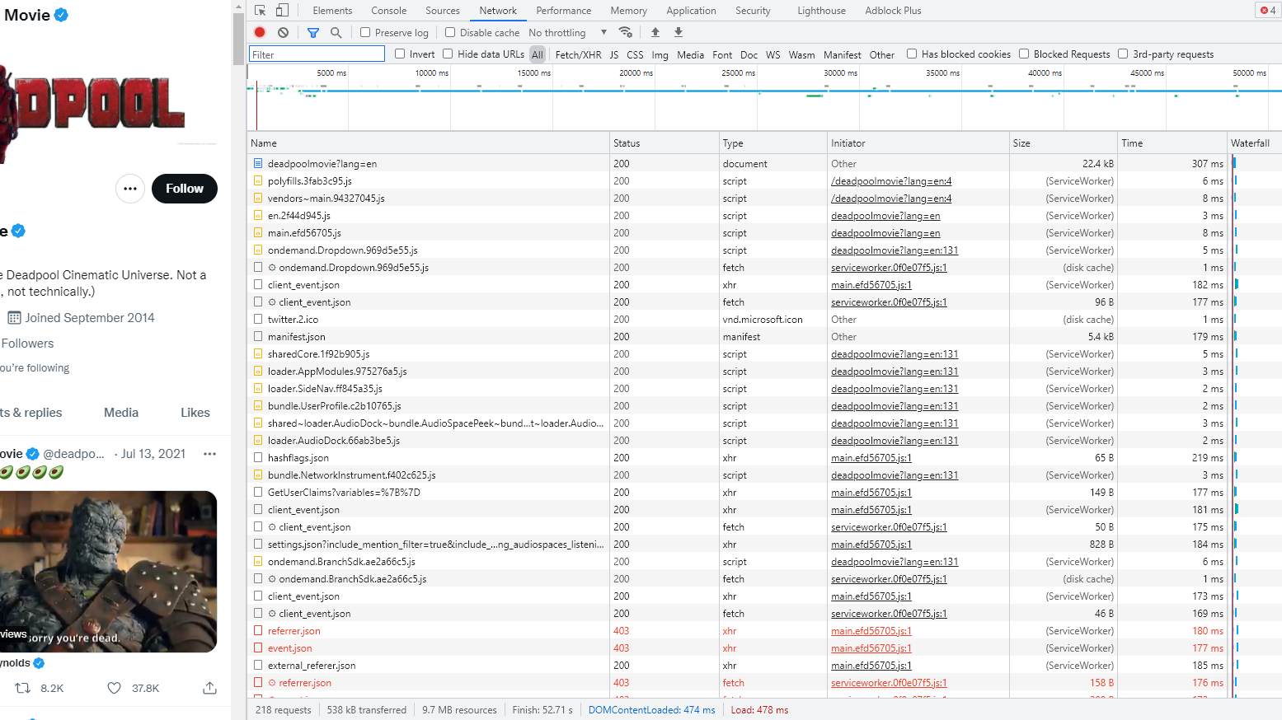

Slide 10

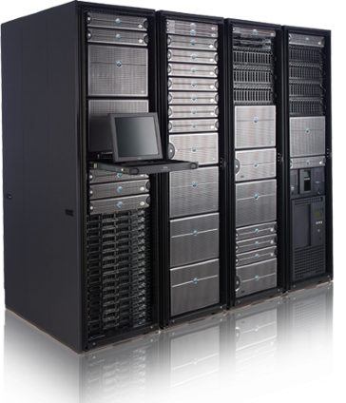

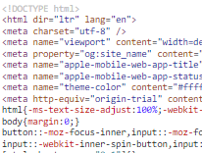
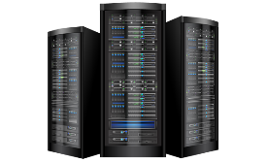

HTTP
5
Get - https://mobile.twitter.com/deadpoolmovie
1
2
Status 200 OK
Get - https://www.google-analytics.com/analytics.js
3
Get - https://api.twitter.com/1.1/jot/client_event.json
Get - https://pbs.twimg.com/profile_images/1208234904405757953/mT0cFOVQ_200x200.jpg
4

Slide 11
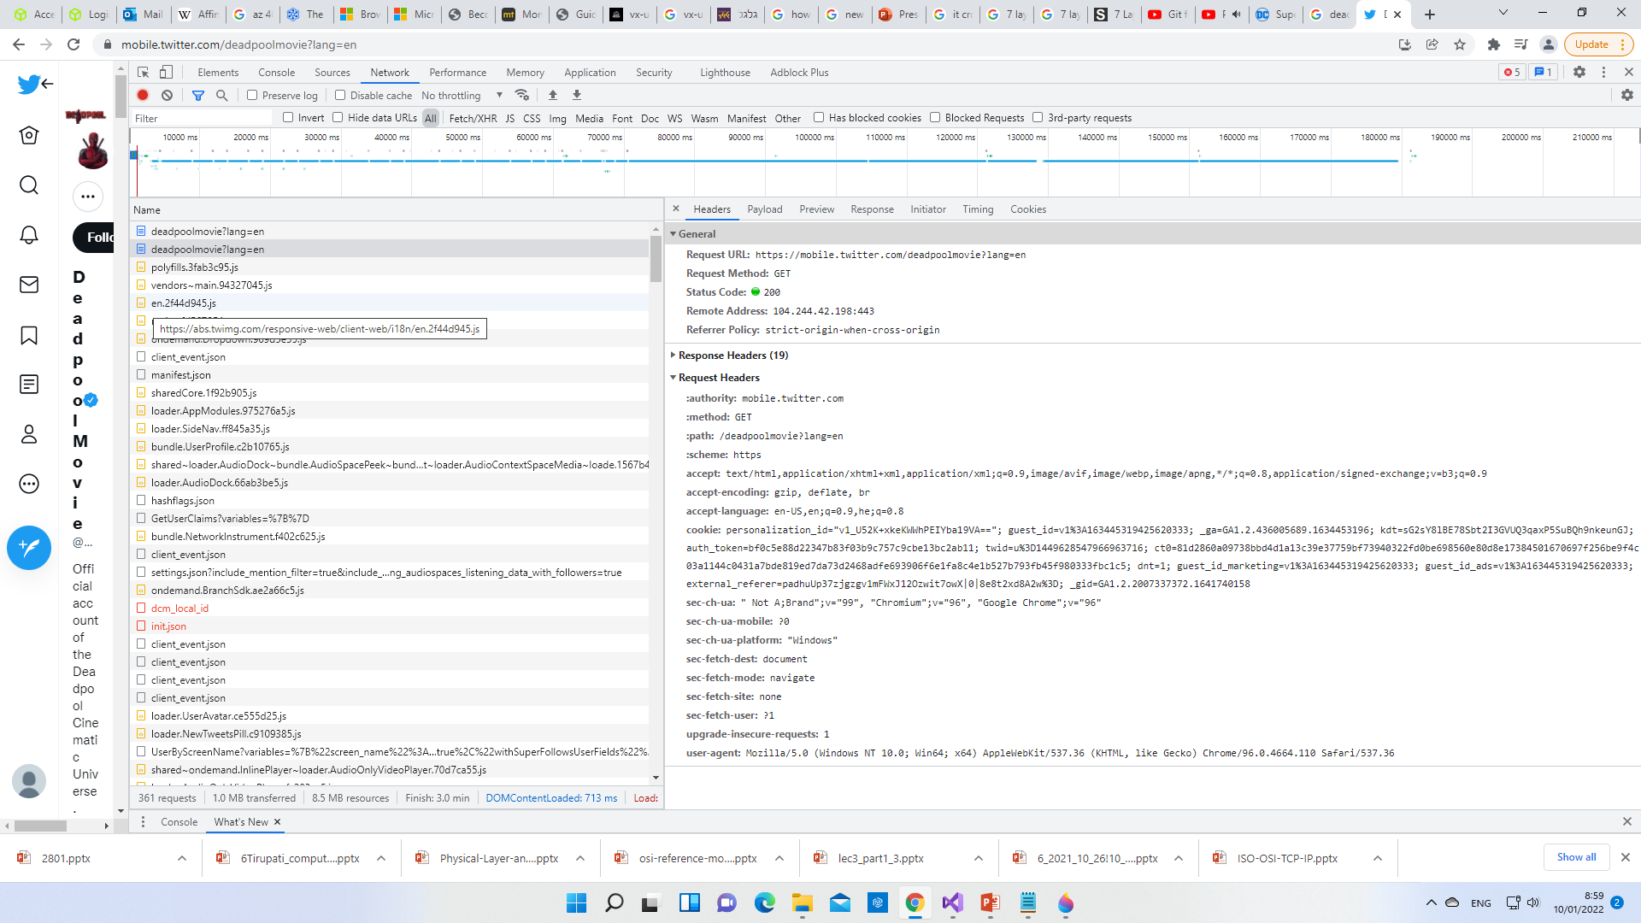

Slide 12
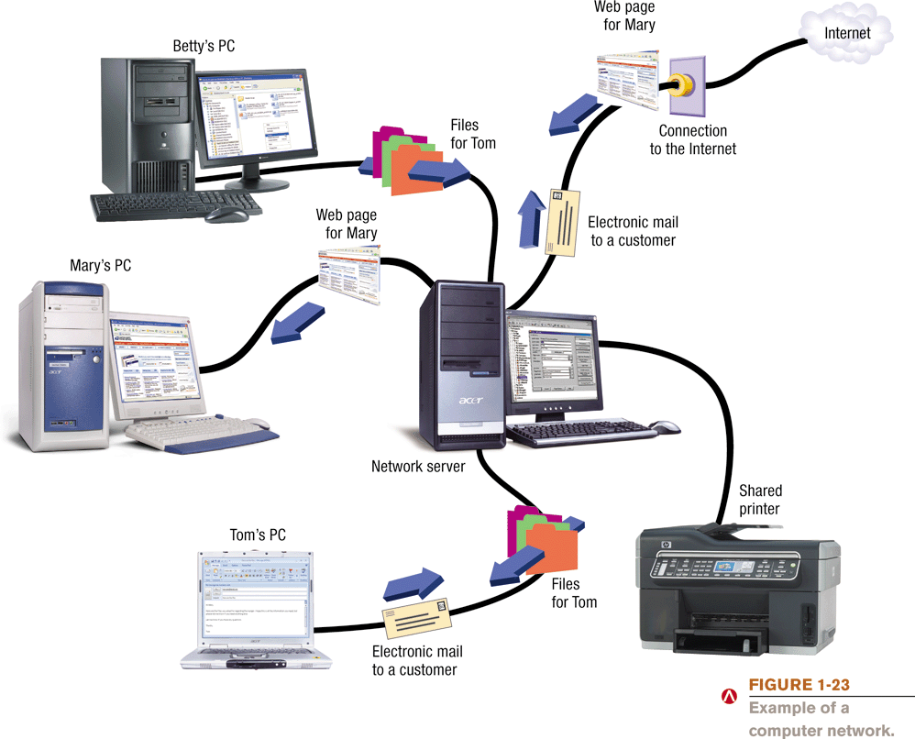
Computer Networks and the Internet

Slide 13
What Are the Internet and the World Wide Web?
Internet: The largest and most well-known computer network in the world
Individuals connect to the Internet using an Internet service provider (ISP)
World Wide Web: One resource (a vast collection of Web pages) available through the Internet
Web sites contain Web pages stored on Web servers
Web pages viewed using a Web browser (Internet Explorer, Safari, Firefox, Opera, etc.
A wide variety of information is available through the Web

Slide 14
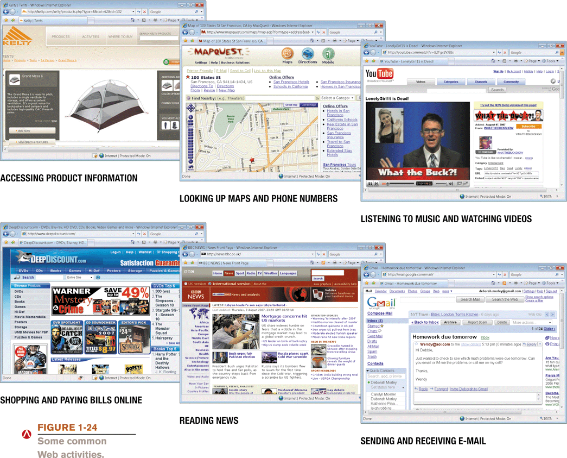
What Are the Internet and the World Wide Web?

Slide 15
Accessing a Network or the Internet
Need a modem or network adapter
Some networks require a username and password
Internet connections can be:
Direct (always-on) connections
Dial-up connections
Internet addresses are used to access resources on the Internet
IP address: Numeric address that identifies computers (207.46.138.20)
Domain name: Text-based address that identifies computers (microsoft.com)
Uniform resource locator (URL): Identifies Web pages (http://www.pbskids.org)
E-mail address: Identifies people for e-mail exchange (jsmith@cengage.com)

Slide 16
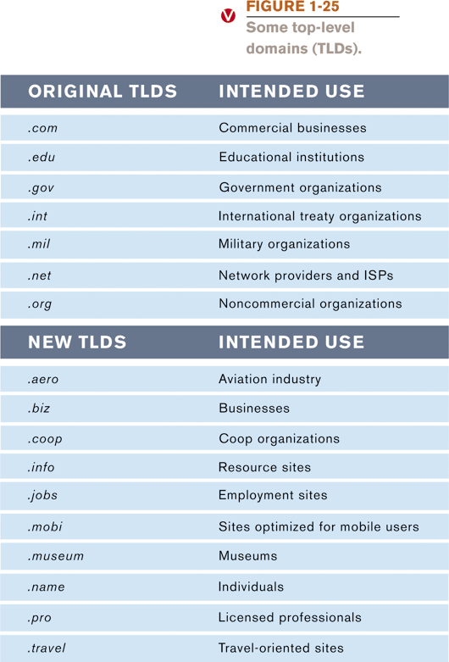
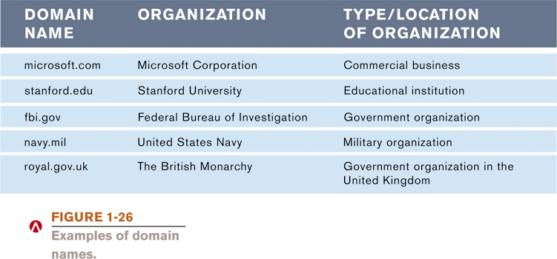
IP Addresses and Domain Names
IP addresses are numeric and unique
Domain Names: Correspond to IP addresses
Top-level domains (TLDs)
identifies type of organization
or its location

Slide 17
Uniform Resource Locators (URLs)
URL: Uniquely identifies a Web page
Consists of:
Information identifying the Web server
Names of folders in which the Web page files are stored
Web page’s filename
Protocols:
Hypertext Transfer Protocol (http) is typically used to display Web pages (https is used for secure Web pages
File Transfer Protocol (ftp) is often used for file exchange

Slide 18
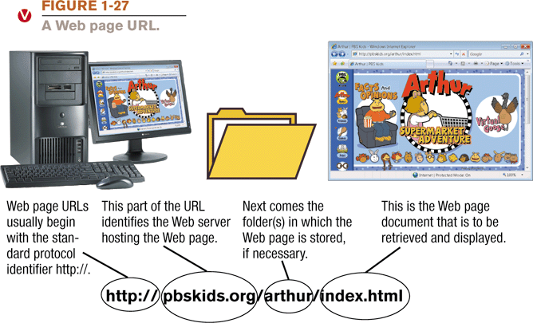
Uniform Resource Locators (URLs)

Slide 19
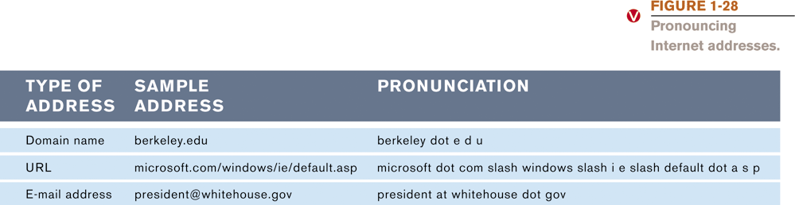
E-Mail Addresses
E-mail addresses consist of:
Username: A persons’ identifying name for a particular domain
The @ symbol
Domain name for the computer that will be handling the person’s e-mail (mail server)
Pronouncing Internet addresses

Slide 20
Surfing the Web
Web browser: Used to display Web pages
Browser home page: The first page displayed when the browser is opened
To load a Web page, you can:
Type a URL in the Address bar
Click a hyperlink on a displayed Web page
Select a Favorite/Bookmark or page from the History list

Slide 21
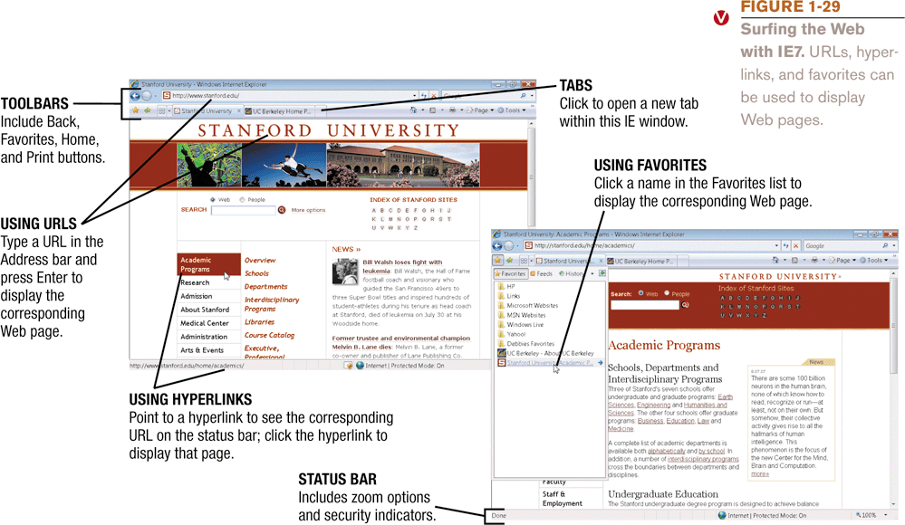
Surfing the Web

Slide 22
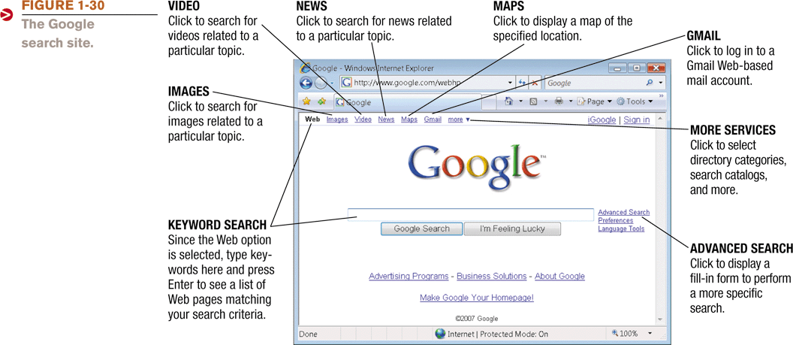
Searching the Web
Search site: Web page that helps you find Web pages containing the information you are seeking
Typically search using keywords
Reference sites: Look up addresses, telephone numbers, ZIP codes, maps, etc.

Slide 23
https/http
Cookies
Base64
User String
Source / Destination IP

